Slide 1
EC2 Instance with access of Dynamo DB

Slide 2
EC2(Elastic Compute Cloud) instance
Open AWS console and Click on EC2 under Compute.
Click on Instances and click on Launch instances.
Chose on Amazon Machine Image(AMI) ,Chose on Instance Type ,configure Instance Details and select IAM role if it is not available create new IAM role.
Click On Create new IAM role.
Click on Create role.
Select type of trusted entity and chose a use cases.
Attach permissions policies what we need.
Now Review and Create Role.
Now select IAM role ,add storage and configure Security Group.
Review and Launch.
Select Key pair and Launch Instance.

Slide 3
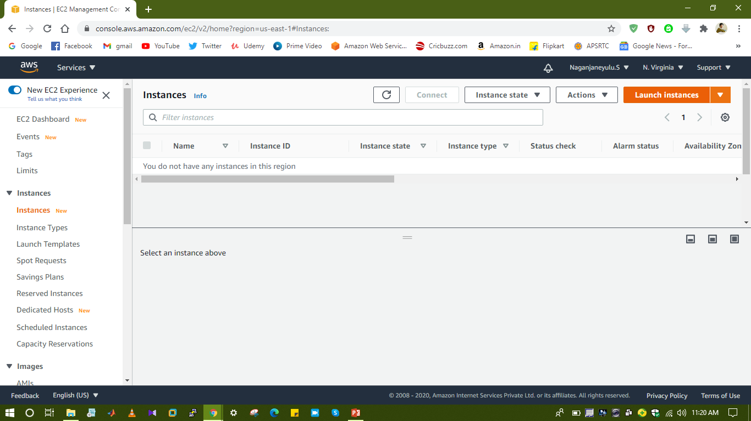
Launch Instances

Slide 4
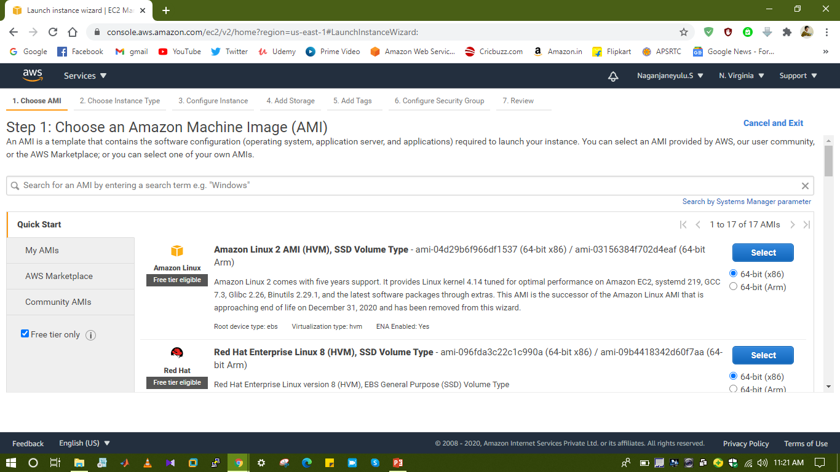

Slide 5
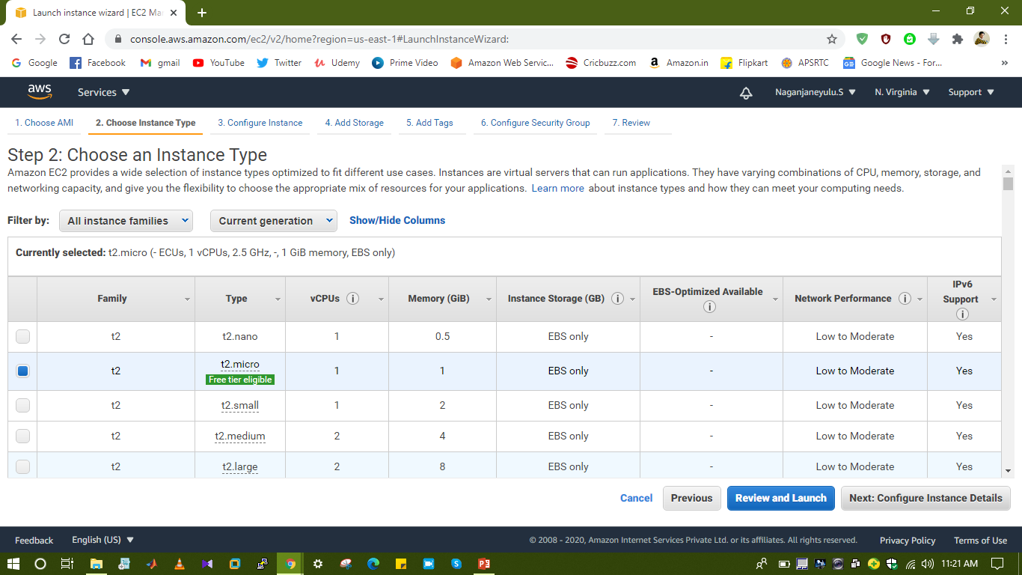

Slide 6
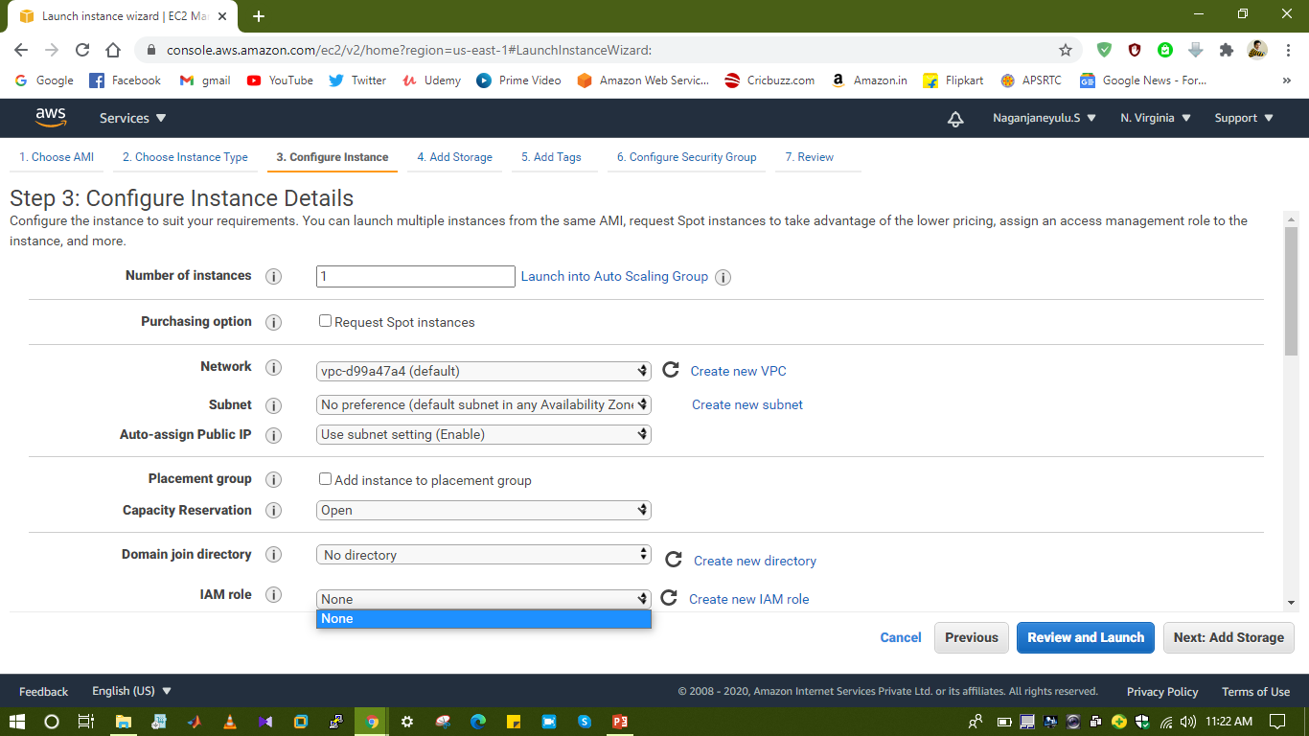

Slide 7
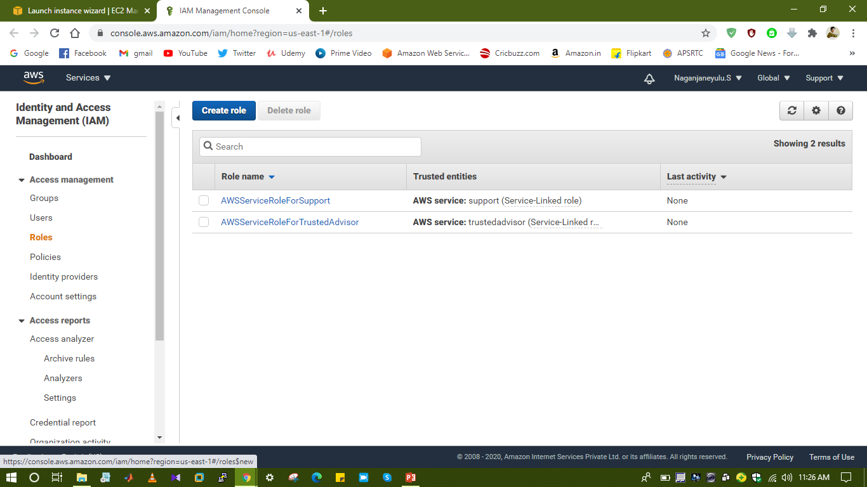

Slide 8
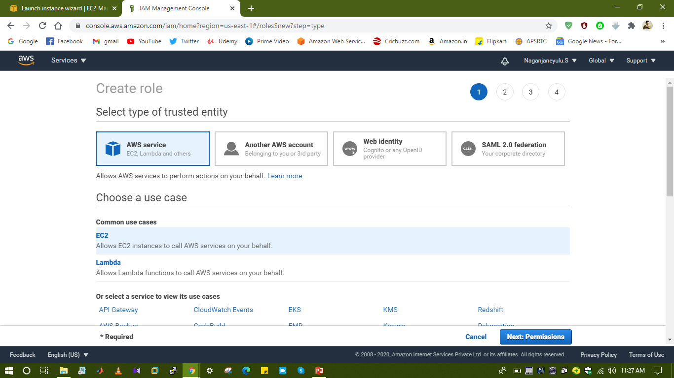

Slide 9
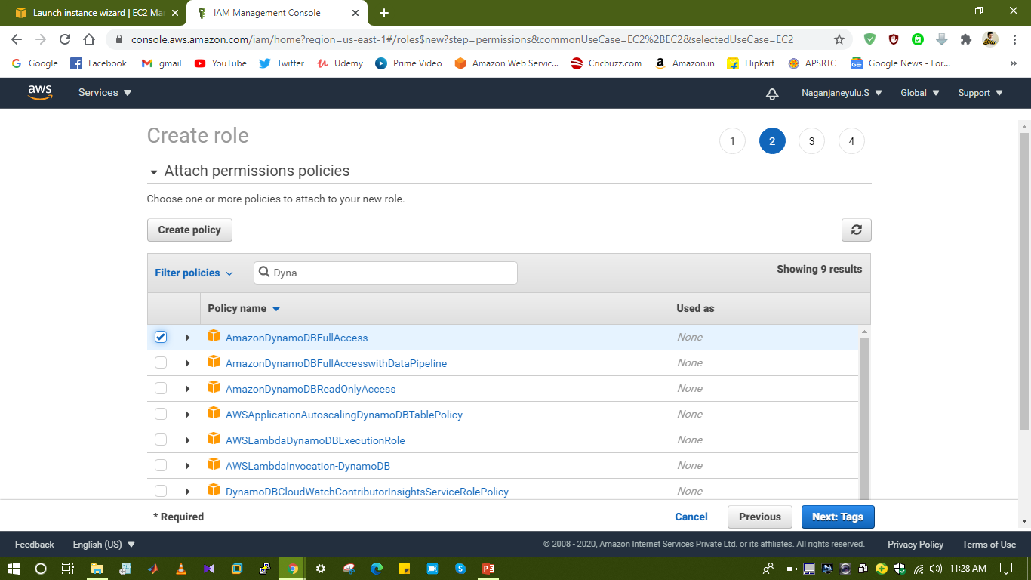

Slide 10
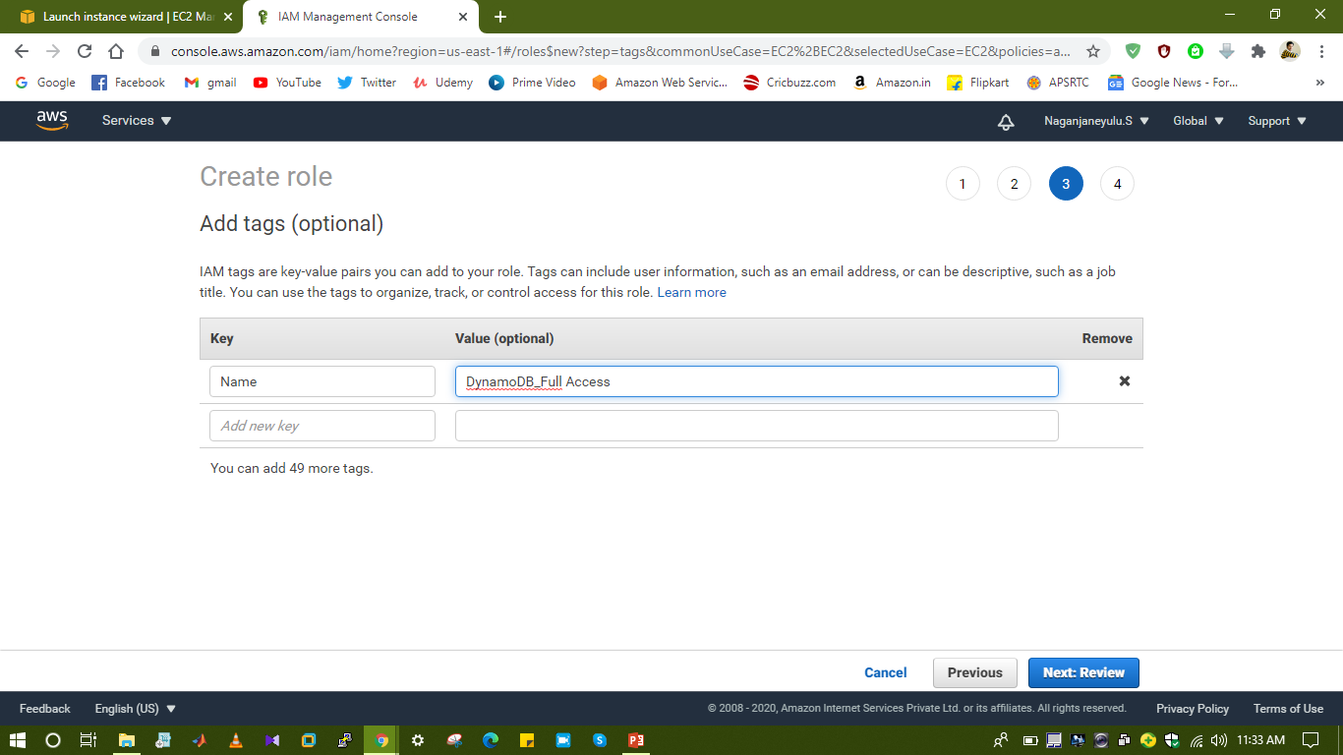

Slide 11
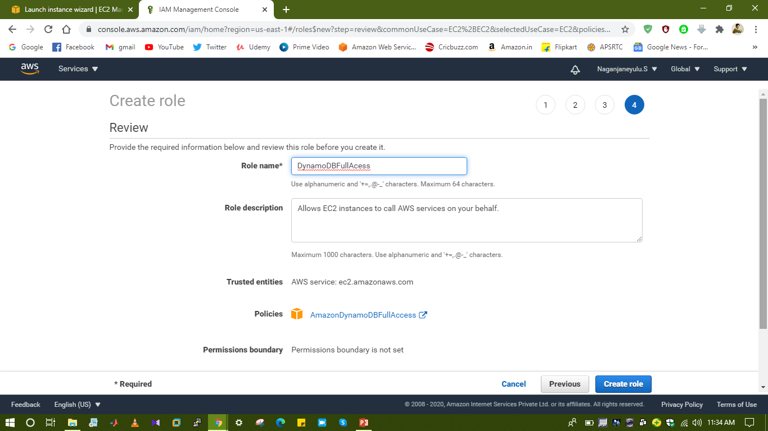

Slide 12
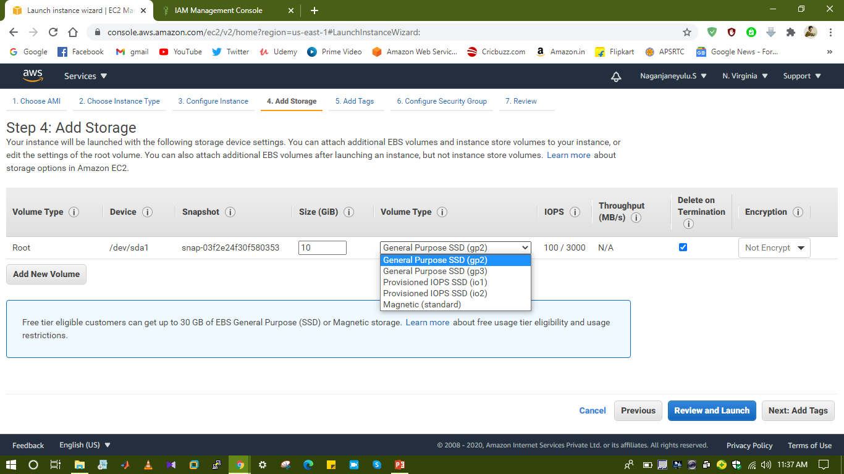

Slide 13
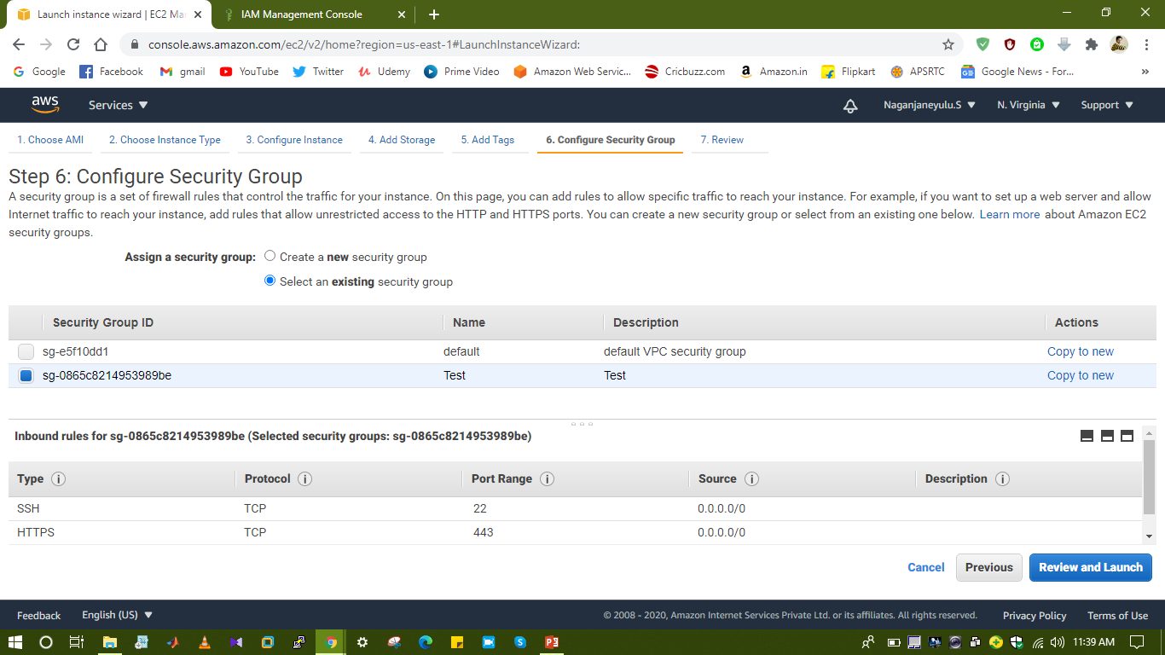

Slide 14
